Slide 1
Apache Hadoop HBASE
Kafal Software Pvt Ltd, 2017 : All Rights Reserved

Slide 2
What is Hbase??
NoSQL database written in java.
Hbase runs on top of HDFS.
Provides BigTable like capabilities to Hadoop.
Hbase provides real time read-write access to large datasets.
Kafal Software Pvt Ltd, 2017 : All Rights Reserved
Notes:
<number>

Slide 3
Hbase Characteristics
Characteristic | Benefit
Fault tolerant | Replication across the data center Atomic and strongly consistent row-level operations High availability through automatic failover Automatic sharding and load balancings of tables
Fast | Near real time lookups In-memory caching via block cache and bloom filters Server side processing via filters and co-processors
Usable | Data model accommodates wide range of use cases Metrics exports via File and Ganglia plugins Easy Java API as well as Thrift and REST gateway APIs
Kafal Software Pvt Ltd, 2017 : All Rights Reserved
Notes:
<number>

Slide 4
Why Hbase?
HBase is a Bigtable clone.
It is open source
It has a good community and promise for the future
It is developed on top of and has good integration for the Hadoop platform, if you are using Hadoop already.
It has a Cascading connector.
Kafal Software Pvt Ltd, 2017 : All Rights Reserved
Notes:
<number>

Slide 5
When to use Hbase?
You need random write, random read or both (but not neither).
You need to do many thousands of operations per second on multiple TB of data.
Your access partners are well known and simple.

Slide 6
Hbase benefits over RDBMS
No real indexes
Automatic partitioning
Scale linearly and automatically with new nodes
Commodity hardware
Fault tolerance
Batch processing

Slide 7
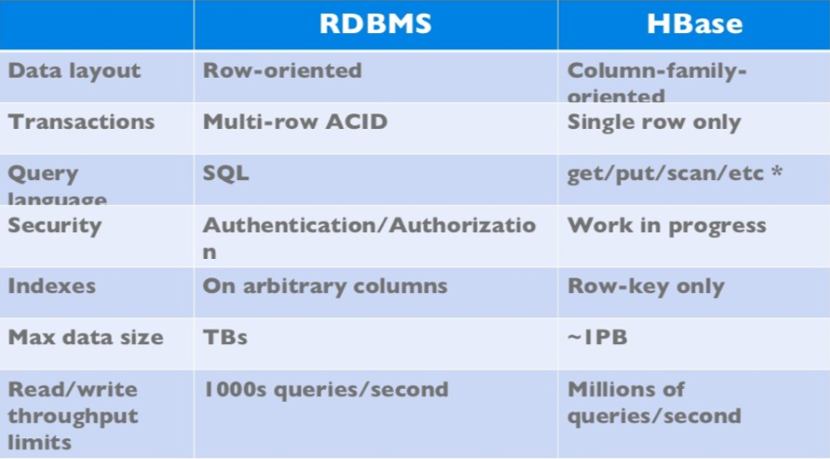
Hbase vs. RDBMS

Slide 8
Hbase Vs. HDFS
Both are distributed systems that scale to hundreds or thousands of nodes.
HDFS is:
good for batch processing (scans over big files)
Not good for record lookup
Not good for incremental addition of small batches
Not good for updates

Slide 9
HBase vs. HDFS (Cont’d)
HBase is designed to efficiently address the following points
Fast record lookup
Support for record-level insertion
Support for updates (not in place)
HBase updates are done by creating new versions of values

Slide 10
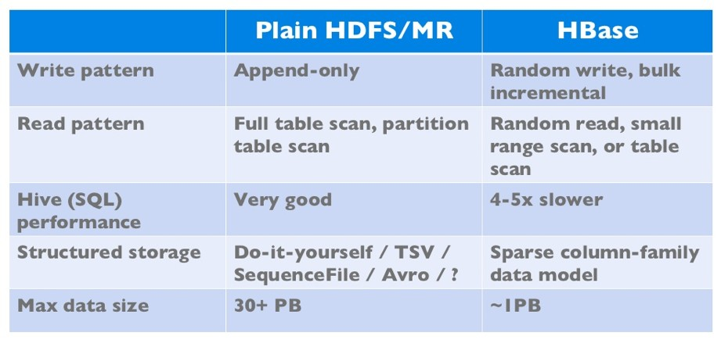
HBase vs. HDFS (Cont’d)
If application has neither random reads or writes ➔ Stick to HDFS

Slide 11
Hbase Architecture
Hbase architecture works on master slave concept.
It has three major components:
Hbase Master (One Master)
Hbase Region Server & Regions (Many)
Zookeeper
Kafal Software Pvt Ltd, 2017 : All Rights Reserved
Notes:
<number>

Slide 12
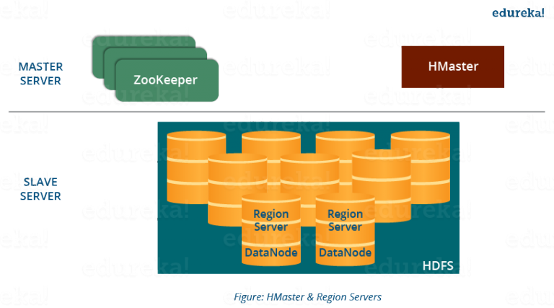

Slide 13
Hbase Components
Region
A table can be divided into a number of regions.
A Region is a sorted range of rows storing data between a start key and an end key.
A Region has a default size of 256MB which can be configured according to the need.
A Group of regions is served to the clients by a Region Server.
A Region Server can serve approximately 1000 regions to the client.
RegionServer (many slaves)
Manages data regions
Serves data for reads and writes (using a log)
Kafal Software Pvt Ltd, 2017 : All Rights Reserved
Notes:
<number>

Slide 14
Hmaster
Hmaster acts similarly as a NameNode in HDFS.
HBase HMaster performs DDL operations (create and delete tables) and assigns regions to the Region servers .
It coordinates and manages the Region Server (similar as NameNode manages DataNode in HDFS).
It assigns regions to the Region Servers on startup and re-assigns regions to Region Servers during recovery and load balancing.
It monitors all the Region Server’s instances in the cluster (with the help of Zookeeper) and performs recovery activities whenever any Region Server is down.
It provides an interface for creating, deleting and updating tables.

Slide 15
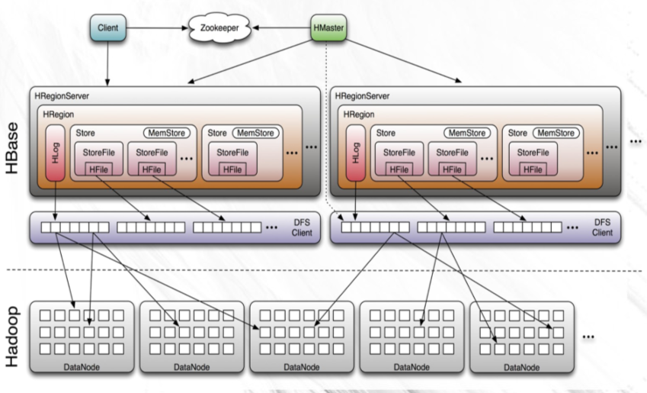
Hbase Architecture in a Hadoop Cluster
Kafal Software Pvt Ltd, 2017 : All Rights Reserved
Notes:
<number>

Slide 16
Hbase Commands

Slide 17
Creating a table
HBaseAdmin admin= new HBaseAdmin(config);
HColumnDescriptor []column;
column= new HColumnDescriptor[2];
column[0]=new HColumnDescriptor("columnFamily1:");
column[1]=new HColumnDescriptor("columnFamily2:");
HTableDescriptor desc= new HTableDescriptor(Bytes.toBytes("MyTable"));
desc.addFamily(column[0]); desc.addFamily(column[1]); admin.createTable(desc);

Slide 18
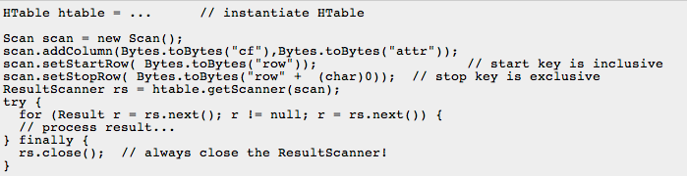
Operations On Regions: Scan()

Slide 19
Operations On Regions: Put()
Insert a new record (with a new key), Or Insert a record for an existing key

Slide 20
Operations On Regions: Put()
Below is the example of inserting rows using HBase put command:
hbase(main):012:0> put 'personal',1,'personal_data:name','Ram' 0 row(s) in 0.0070 seconds
hbase(main):013:0> put 'personal',1,'personal_data:city','Bengaluru' 0 row(s) in 0.0070 seconds
hbase(main):014:0> put 'personal',1,'personal_data:age','25' 0 row(s) in 0.0070 seconds
hbase(main):015:0> scan 'personal’
ROW COLUMN+CELL
1 column=personal_data:age, timestamp=1505285659934, value=25
1 column=personal_data:city, timestamp=1505285653043, value=Bengaluru
1 column=personal_data:name, timestamp=1505285635428, value=Ram
1 row(s) in 0.0130 seconds
hbase(main):016:0>

Slide 21

Operations On Regions: Delete()
Marking table cells as deleted
Multiple levels
Can mark an entire column family as deleted
Can make all column families of a given row as deleted
All operations are logged by the RegionServers.
The log is flushed periodically

Slide 22
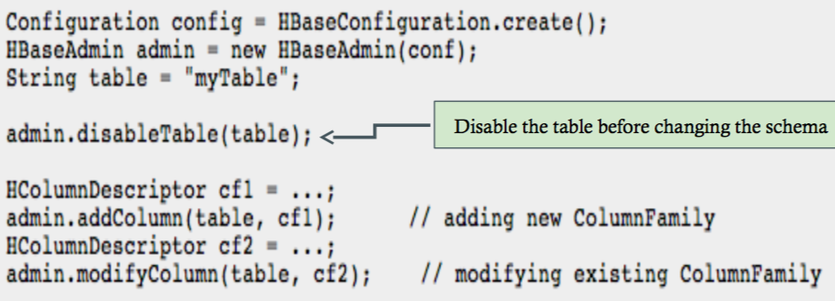
Altering a table
Admin.enableTable(table);

Slide 23
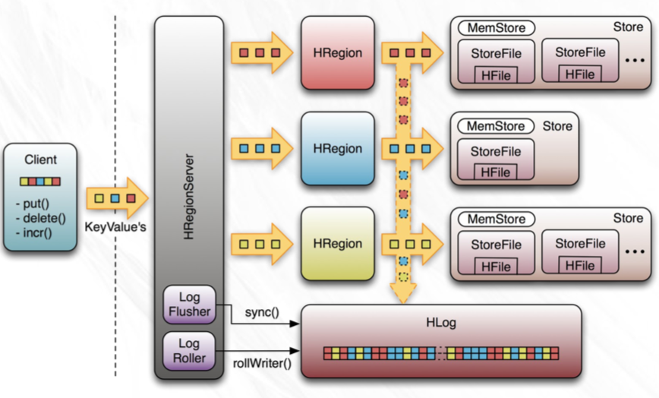
Logging operations

